Slide 1
IT Security and Penetration Testing
Chapter 18
Incident Handling

Slide 2
Objectives
Identify the necessity of incident handling
Identify different types of incidents
Recognize the various phases of incident handling
Note the phases in preparing for incident handling
Computer Security and Penetration Testing

Slide 3
Objectives (continued)
Describe the steps in the identification of incidents
Understand the need for incident reporting and communication
Describe the steps in removing a bug
Identify the steps in recovering from an incident
Computer Security and Penetration Testing

Slide 4
Objectives (continued)
Identify the importance of following up after incident handling
Understand the process of tracking hackers
List emergency steps that follow an incident
Computer Security and Penetration Testing

Slide 5
Incident Handling
An incident in a computer-security environment
  An event that tests the security solutions in place on a network
    Or, in the case of a stand-alone machine, on that machine itself
Incidents take many forms
  The most common incidents that affect network security are attacks from malicious code
Any incident can be a serious threat to an organization’s network
Computer Security and Penetration Testing

Slide 6
Incident Handling (continued)
Common events that may indicate an attack in progress
  Execution of an unusual process using network resources
  A pattern of many employee complaints of computer malfunctions
  Resource requests may increase in an unusual way
  An authentication request by an IP address that is not a part of the network
Computer Security and Penetration Testing

Slide 7
Incident Handling (continued)
To prevent the occurrence of such incidents, an administrator must develop three documents:
  A predictive document describing the possible threats to the network
  A “hot list” of what to prevent, what to patch, and what to endure
  An incident response policy to ensure the smoothest possible response to any threat
Computer Security and Penetration Testing

Slide 8
Need for Incident Handling
Reasons to develop effective incident handling policies:
  Less confusion when an incident occurs
  Number of incidents is reduced when organizations take preventative measures
  Organizations that handle and document incidents may be less likely to have repeat occurrences
  Proper incident handling helps organizations assess the strengths and weaknesses
Computer Security and Penetration Testing

Slide 9
Need for Incident Handling (continued)
Reasons to develop effective incident handling policies: (continued)
  Documented handling of incidents using industry standard practices safeguard an organization from potential legal ramifications related to the incidents
  Properly trained incident-response teams give upper management time
    To prepare a factual and community-involved official response to the aftermath of a security breach
Computer Security and Penetration Testing

Slide 10
Types of Incidents
Defaced Pages
  Means an attacker has hacked your Web server
  Results in loss of revenue, reputation, and morale of a company
Denial-of-Service Attacks
  Send a large quantity of packets to a server so that resources are overutilized
    Servers can’t process legitimate requests sent by valid users
  Three subcategories: buffer overflow conditions, network flooding, and stack errors
Computer Security and Penetration Testing

Slide 11
Types of Incidents (continued)
Errors and Omissions
  Any intentional or unintentional misconfiguration of any resource on the network
  Errors or omissions in the code base of any and all applications and system software
  Do not always lead to incidents
Fraud and Theft
  Can be performed either by traditional practices or by using new tools
  Most incidents of fraud involve “inside” individuals
Computer Security and Penetration Testing

Slide 12
Types of Incidents (continued)
Intrusion
  Any attempt to gain unauthorized access to a network
  Intruder can be either an insider or an outsider
  Does not always lead to incidents
Quiet Intrusion
  May be the most devastating for organizations
  Occurs when a hacker intrudes undetected into the network of an organization
    And leaves little or no trace of his actions
Computer Security and Penetration Testing

Slide 13
Types of Incidents (continued)
Quiet Intrusion (continued)
  Categories
    Retrieving information
    Corrupting data
    Creating or identifying back doors
Malicious Code
  Used for destructive purposes only
  Worms, viruses, and Trojan horse programs
  Designed to enter the network unnoticed
  Many are designed to replicate and distribute themselves automatically
Computer Security and Penetration Testing

Slide 14
Phases of Incident Handling
The key phases of incident handling are:
  Preparation
  Identification
  Reporting (Logging)
  Setting urgency
  Setting priority
  Eradication
  Recovery
  Postmortem
Computer Security and Penetration Testing

Slide 15
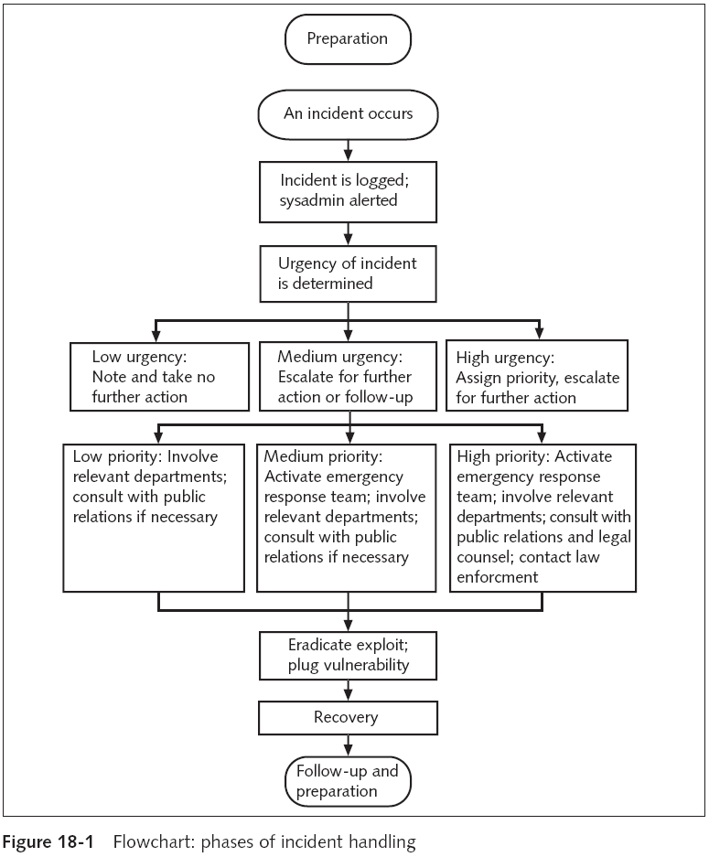
Computer Security and Penetration Testing

Slide 16
Preparation for Incident Handling
Phases include
  Knowing the resources and their vulnerabilities
  Baselining the network to discover all the assets involved
  Developing systems and policies
    Including creating the incident-response team
Computer Security and Penetration Testing

Slide 17
Preparation for Incident Handling (continued)
Planning an Incident-Handling Policy
  All organizations should devise a formal incident-handling policy with the following sections
    Purpose and sponsor
    Network and system details
    Policy
    Procedures
    Responsible organizations
    History
Organization should identify the skill sets required to address the expected range of vulnerabilities
Computer Security and Penetration Testing

Slide 18
Incident-Handling Team
Responsible for identifying incidents and responding to them in the most effective manner possible
Skills represented in an emergency response team cross department lines
Minimally, the team needs
  Somebody with experience and skill at identifying attack signatures and responses
  Somebody with enough clout within the organization
  Somebody who can systematize communications within the team and with outside entities
Computer Security and Penetration Testing

Slide 19
Incident-Handling Team (continued)
Incident-handling teams should practice exercises and drills
Team should also be trained to retain the evidence of an incident
The more efficient and effective the incident-handling team is
  The lower the losses in productivity, time, money, and labor
Computer Security and Penetration Testing

Slide 20
Identifying Incidents
The first step in an incident response is
  To identify whether an incident is actually occurring
A properly prepared network infrastructure has IDS and firewalls in place
  Applications provide the administrators with alert messages
Administrator has to deal with false positives and false negatives
Computer Security and Penetration Testing

Slide 21
Identifying Incidents (continued)
Steps for ascertaining whether there has been an attack
  Administrator confirms that the issue is an actual security incident
  Network services that may have been affected must be identified
  Appropriate historical documents and current vulnerability alerts ought to be reviewed
  Incident-response team performs forensics to determine the type of incident
    And the possible responses
Computer Security and Penetration Testing

Slide 22
Identifying Incidents (continued)
Security experts use the following tools to make their determinations:
  Approach to incident detection
  Assessing the severity of the incident
  Risk assessment
  Systems and network logging
Computer Security and Penetration Testing

Slide 23
Approach to Incident Detection
Can seriously impact the number and kinds of incidents that are detectable
First step is called watching
  Important to monitor a network for unusual activity
Next step is checking details of a possible incident
Last step is taking action
Specific procedures to ensure that incidents are detected prior to damaging a network
Computer Security and Penetration Testing

Slide 24
Approach to Incident Detection (continued)
A large part of the detection process is ensuring that proper monitoring tools are available on the network
Confidential files must be stored in a secure area
Network administrator must learn to read the system logs of the resources on the network
  And look for possible attacks
Computer Security and Penetration Testing

Slide 25
Approach to Incident Detection (continued)
Detection Tools
  Installed on the network to make early detection possible
  Types
    System-monitoring tools
    Network analysis tools
    User-analysis tools
    Log-analysis tools
Computer Security and Penetration Testing

Slide 26
Assessing the Severity of an Incident
The scale of response changes depending on the scale of the problem
Potential damage from an attack may include monetary loss
  But it can also result in a loss of productivity, company standing, or customer trust
Severity is also determined by the number of network resources involved
  Both directly and indirectly
Computer Security and Penetration Testing

Slide 27
Assessing the Severity of an Incident (continued)
Many types of attacks are capable of replicating themselves
  Make it difficult to determine the number of computers that may have been affected
  Are often considered high-severity attacks
Severity level may also be affected by the motive of the attacker
Computer Security and Penetration Testing

Slide 28
Risk Assessment
Ongoing risk assessment is done for each incident
  To determine whether to use the affected computer on the network
Options for dealing with the affected computer:
  Shut it down, disconnect it from the network, or continue incident-handling operations
    And enable the computer to remain on the network
Computer Security and Penetration Testing

Slide 29
Systems and Network Logging
When an incident is discovered
  The first sources for information are the log files on the affected machine
    And general network traffic logs from routers and switches
UNIX and Linux Log Files
  syslog
  auth.log
  checksecurity.log
  mail.err, mail.log, and mail.warn
Computer Security and Penetration Testing

Slide 30
Systems and Network Logging (continued)
Windows Log Files
  To view Windows system logs, you open the GUI Event Viewer
    In the Administration Tools control panel
Additionally, a check needs to be performed for suspicious files
Computer Security and Penetration Testing

Slide 31
Reporting and Communicating Incidents
All users on the network should know how to report a possible incident
  Even minor incidents should be noted
The appropriate people to be notified should be listed in an organization’s security policy
Incidents must be reported in a uniform way
  Automated intranet forms can be used
Computer Security and Penetration Testing

Slide 32
Reporting the Incident
The following experts may need to be informed:
  System administrator
  Senior management
  Legal counsel
  System and network users
  Human-resource department
  Public-relations department
  Federal, state, or local law-enforcement agencies
Computer Security and Penetration Testing

Slide 33
Reporting the Incident (continued)
Incident should be reported in direct and clear language outlining the facts
All information of the incident should be reported
Incident should be reported with neutral tone
  Using nontechnical language in reports to upper management
The hacked resource is not the best tool for spreading information about the attack
Computer Security and Penetration Testing

Slide 34
Communicating the Incident
Refers to the official communication with the individuals fixing the incident
  Different from incident reporting
Includes the following tasks listed below:
  Identifying people with skills that make them useful in handling the incident
  Determining how much information should be communicated to the relevant experts
  Determining the amount of responsibility to be delegated to individuals
Computer Security and Penetration Testing

Slide 35
Communicating the Incident (continued)
Includes the following tasks listed below: (continued)
  Determining the mode of communication, and securing communications
  Identifying an incident-handling team leader to be responsible for bringing the incident to successful closure
Computer Security and Penetration Testing

Slide 36
Eradicating the Bug
One of the key steps while eradicating bugs is to create backup copies of files
Making backup copies refers to taking snapshots of the system to store and preserve
  Helps tracking the hacker after the incident
Following information must be retrieved:
  A report of the process status with the parent process ID of each process
  A report of all the open connections
  A backup copy of the temp directory
Computer Security and Penetration Testing

Slide 37
Eradicating the Bug (continued)
In Linux, you may use the following archival commands to make backup copies
  tar
  dump
  dd
Computer Security and Penetration Testing

Slide 38
Correcting the Root Problem
To properly clear the network of problems caused by the incident
  An analysis should be performed
  Knowledge obtained from previous incidents should be consulted
Accuracy of analysis of the problem is important
Important to remove all traces of the incident from the network
Computer Security and Penetration Testing

Slide 39
Identifying and Implementing the Steps to Fix the Problem
Virus and Worm Attacks
  Isolate the computers that have been affected
  Disconnect the affected computers from the network to stop the virus or worm from spreading
Hacker or Cracker Attacks
  Hacker attack may occur in three different ways:
    Activating a new session, terminating an active session, or hijacking an active session
  An unskilled hacker’s actions can be tracked by viewing the log files
Computer Security and Penetration Testing

Slide 40
Identifying and Implementing the Steps to Fix the Problem (continued)
Hacker or Cracker Attacks (continued)
  If the hacker has ended the session
    The first step for the incident-handling team is to identify the part of the network that was affected
  The best chance to catch a cracker is when she is working through an open session
Denial-of-Service Attacks
  Identify areas that would be affected if the attack is successful
  Determine the attack method used by the hacker
Computer Security and Penetration Testing

Slide 41
Identifying and Implementing the Steps to Fix the Problem (continued)
Denial-of-Service Attacks (continued)
  Locate a point where the attack can be stopped that will cause minimal disruption
  Implement the procedures that need to be taken to block the attack
  Reestablish normal network conditions
  Analyze any loopholes in network security
  Identify permanent solutions to cover security loopholes
  Implement the chosen solutions
Computer Security and Penetration Testing

Slide 42
Recovering from Incidents
After an incident, recovery without permanent damage is the goal
The network should be made functional so that the organization will face no further revenue loss
Computer Security and Penetration Testing

Slide 43
Phases of Recovery
Reinstallation
  All infected computers must be either reinstalled or fixed with a patch
  All the computers that were not infected should be patched as well
Computer Security and Penetration Testing

Slide 44
Phases of Recovery (continued)
Reinstallation (continued)
  During reinstallation, check for the following:
    Verify that no traces of the incident are left
    Implement security checks on the network so the problem does not arise again
    Change the administrative password and users’ passwords
    Make a backup copy of the newly installed settings so that if a hacker attacks again, the process of reinstalling is faster
Computer Security and Penetration Testing

Slide 45
Phases of Recovery (continued)
Reauthentication
  It may be necessary to disable all accounts and then reenable the accounts
    Pruning the unknown or unused accounts
Scanning
  Scanning checks should be performed after the repair, reinstallation, and reauthentication
Resuming work
  Users may resume their work after all steps have been completed
Computer Security and Penetration Testing

Slide 46
Postmortem
After the problem has been fixed
  The next step is to derive lessons that can be implemented in the future
Teams must analyze the incident to identify the possible root cause of the problem
  Identifies the weak areas in network security
  Implies a roadmap to the next continuing vulnerability to be fixed
Computer Security and Penetration Testing

Slide 47
Identifying the Root Cause of the Problem
Incident-handling teams need to perform this step in a predetermined way
  Teams must ask how and why a problem occurred
Some of the questions to be addressed
  How did the hacker manage to hack into the network in the first place?
  How can the network have more security to avoid more incidents in the future?
  What tools and patches were missing that permitted the hacker to detect a loophole in the network?
Computer Security and Penetration Testing

Slide 48
Identifying the Root Cause of the Problem (continued)
Some of the questions to be addressed (continued)
  What processes or technology could have helped the incident-handling team fix the issue quickly and efficiently?
  Are there any changes that need to be made in the incident-response policy?
  Is there a better network design that will not allow the hacker to perform operations, even if the hacker manages to break in?
Computer Security and Penetration Testing

Slide 49
Identifying Short-Term and Long-Term Changes
After the analysis of the root cause has been completed
  An action list should be developed
A logical progression of economically feasible steps should be generated and then converted into action
Tasks for the incident-handling teams should be provided to only the members of the incident-handling teams
Computer Security and Penetration Testing

Slide 50
Identifying Actions for Any Unpredictable Incident
Knowledge obtained from the root cause analysis (RCA) should be implemented
  In areas that were affected by the previous incident as well as other areas vulnerable to attacks
Computer Security and Penetration Testing

Slide 51
Implementing the Learning
The last step of the postmortem phase
  The people involved implement the learning derived from the incident
Computer Security and Penetration Testing

Slide 52
Tracking Hackers
Unethical hackers are often educated
  Hackers can be roughly divided into two categories: amateurs and experts
Tracking hackers requires patience and coordination
  And support from people and organizations across the world
  Combination of both technology and psychology
Two approaches to tracking hackers: “generic to specific” and “specific to generic to specific”
Computer Security and Penetration Testing

Slide 53
Generic to Specific
Data whose outline is broad in the beginning
  Yet, with the use of evidence and logic, the output is specific
Initially, the hacker-tracking team knows only that an attack was performed
Later they discover the details about the technology used
In the end, the team may be able to locate the individual
Computer Security and Penetration Testing

Slide 54
Specific to Generic to Specific
Information collated before tracking the hacker is very specific
  And leads to a generic analysis about the hacker
Log files, ISP server data, and assessments of existing vulnerabilities
  Provide information regarding the hacker
Computer Security and Penetration Testing

Slide 55
Specific to Generic to Specific (continued)
Generic steps to trace a hacker:
  Analyze log files for signatures regarding the hacker
  Analyze the attacker’s possible motivation based on the results of the hack
  Divide timelines
  Define geographical sectors
  Identify any links that transmitted similar data
  Pinpoint the location of the hacker
Computer Security and Penetration Testing

Slide 56
Emergency Steps
The following is an emergency guide for use in case of an attack
Computer Security and Penetration Testing

Slide 57
Important Emergency Steps
Emergency steps include:
  Stay calm
  Take accurate and comprehensive notes
  Notify the relevant set of people
  Confirm that it is an incident and not an event
  Use secure modes of communication
  Avoid spreading the problem
  Make backups
Computer Security and Penetration Testing

Slide 58
Summary
An incident in a computer security environment is an event that tests the security solutions in place
Most common incidents are attacks from malicious code and inside jobs by employees, contractors, and consultants
Damage from incidents could range from a small disruption of work to a major network outage
Be aware of common events may point to an attack in progress
To prevent and properly respond to incidents, an administrator must develop a predictive document
Computer Security and Penetration Testing

Slide 59
Summary (continued)
Every organization has a unique mix of resources and vulnerabilities
The key phases of incident handling are preparation, identification, reporting (logging), setting urgency, setting priority, eradication, recovery, and postmortem
All users on a network should know how to report a possible incident
When eradicating bugs, incident-handling teams need to create backup copies of files by taking snapshots of the system
Computer Security and Penetration Testing

Slide 60
Summary (continued)
After an incident, recovery without permanent damage is the goal
The four phases of recovery from incidents are reinstallation, reauthentication, scanning to check eradication, and resuming work
Important to learn from successes and from mistakes
Two approaches to tracking hackers: “generic to specific” and “specific to generic to specific”
Know how to handle an emergency
Computer Security and Penetration Testing

